Slide 1
Chapter 10

Slide 2
Objectives

Slide 3
Objectives (continued)

Slide 4
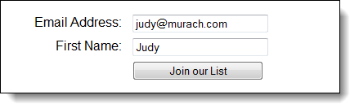
A form in a web browser

Slide 5
The HTML for the form

Slide 6
Attributes of the form element

Slide 7
Terms

Slide 8
HTML5 controls for input data

Slide 9
The basic HTML5 attributes for working with forms

Slide 10
A form that uses some HTML5 controls and attributes

Slide 11
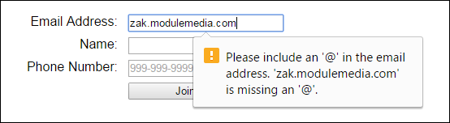
The form in Chrome with an error message

Slide 12
The HTML5 attributes for data validation

Slide 13
CSS3 pseudo-classes for required, valid, and invalid fields

Slide 14
The HTML for a form that uses HTML5 attributes for data validation

Slide 15
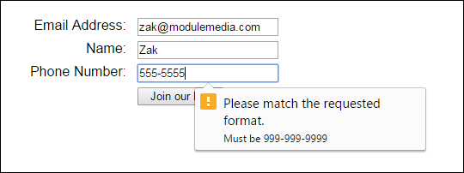
The form in Chrome with an error message

Slide 16
Two of the reasons why you need JavaScript for data validation

Slide 17
The jQuery selectors for form controls

Slide 18
The jQuery methods for getting, setting, and trimming control values

Slide 19
How to get the value of a numeric entry from a text box

Slide 20
How to get the value of the checked radio button in a group

Slide 21
How to get an array of the selected options from a list

Slide 22
The jQuery event methods for forms

Slide 23
A handler that disables or enables radio buttons when a check box is checked or unchecked

Slide 24
The jQuery methods for triggering events

Slide 25
A handler that triggers the submit event after some data validation

Slide 26
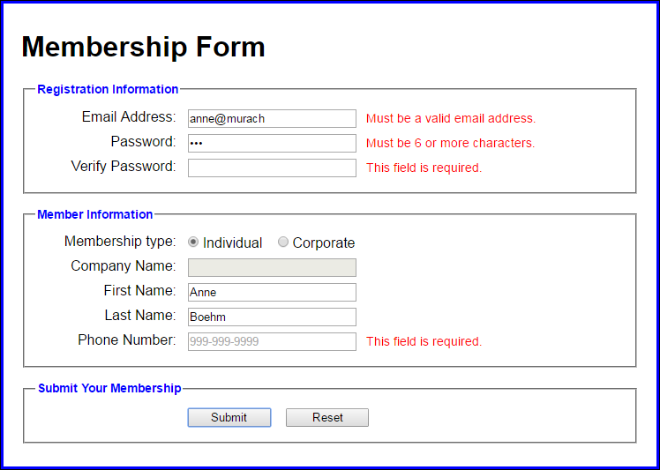
The form for a Validation application

Slide 27
The HTML for the Validation application

Slide 28
The HTML (continued)

Slide 29
The HTML (continued)

Slide 30
JavaScript validation for the application

Slide 31
JavaScript validation (continued)

Slide 32
JavaScript validation (continued)

Slide 33
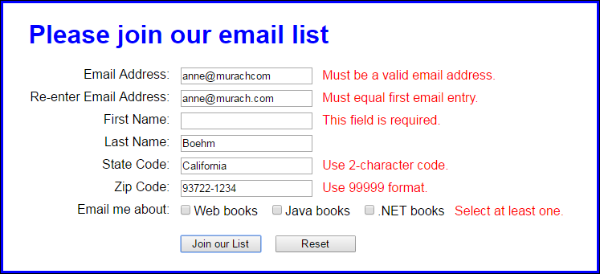
Exercise 10-1 Validate with JavaScript

Slide 34
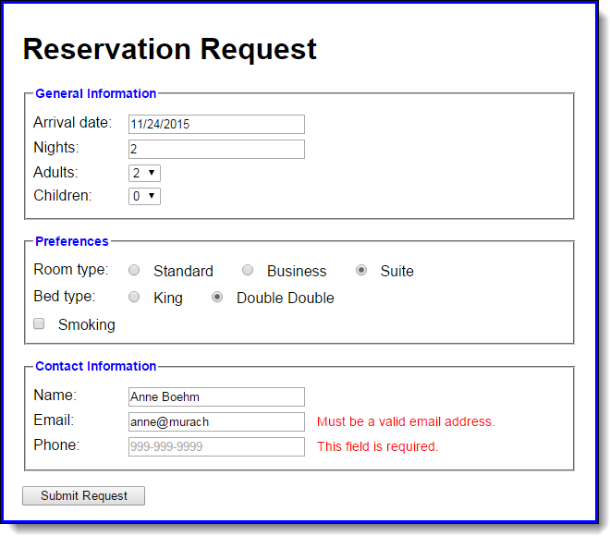
Extra 10-1 Use JavaScript to validate a form

